Slide 1
Final Presentation
Jonathan Tornberg
INLS 620
November 29th 2018

Slide 2
Background
Dataset found on Kaggle.com
Format = Comma separated value (CSV) in a tabular one spreadsheet model
Background: Dataset of baseball teams from 1871 – 2015
Homeruns, ERA, Games, Wins, Losses, World Series Winner, Hits, etc.
Fully open source
Could not find any previously published linked data in relation to this dataset

Slide 3
Methodology
Began with a fairly clean dataset
Some columns (i.e. divID had blank values)
Approach to writing RDF triples
Began with primary root node: TeamSeason
Therefore all relevant triples began with this subject in the URI format “http://example.org/season/[year][franchise ID]
Edited RDF skeleton to add appropriate data types for each resource
No good pre-existing vocabularies that would be useful → defined my own “MLB”

Slide 4
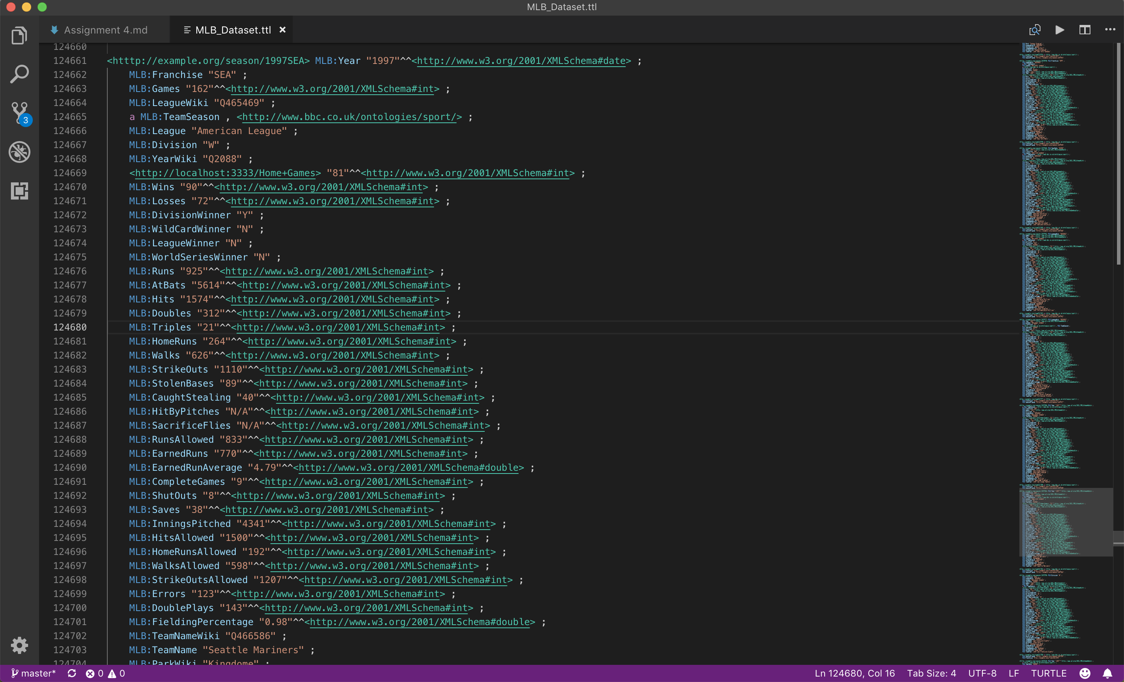

Slide 5
Methodology Cont.
Reconciliation Process:
Was able to find WikiData entries for the following resources:
Year, league, team name, and park name
For those I was not able to find, I left with the literal value
Some values had park 1, 2, or 3 – for these I removed the numeric value and left just the string value
Reconciliation of numeric values would not be of much use without context
SPARQL Preparation
In order to avoid having just the WikiData ID show up in query results, I added new columns for each reconciled resource with just the literal value.

Slide 6
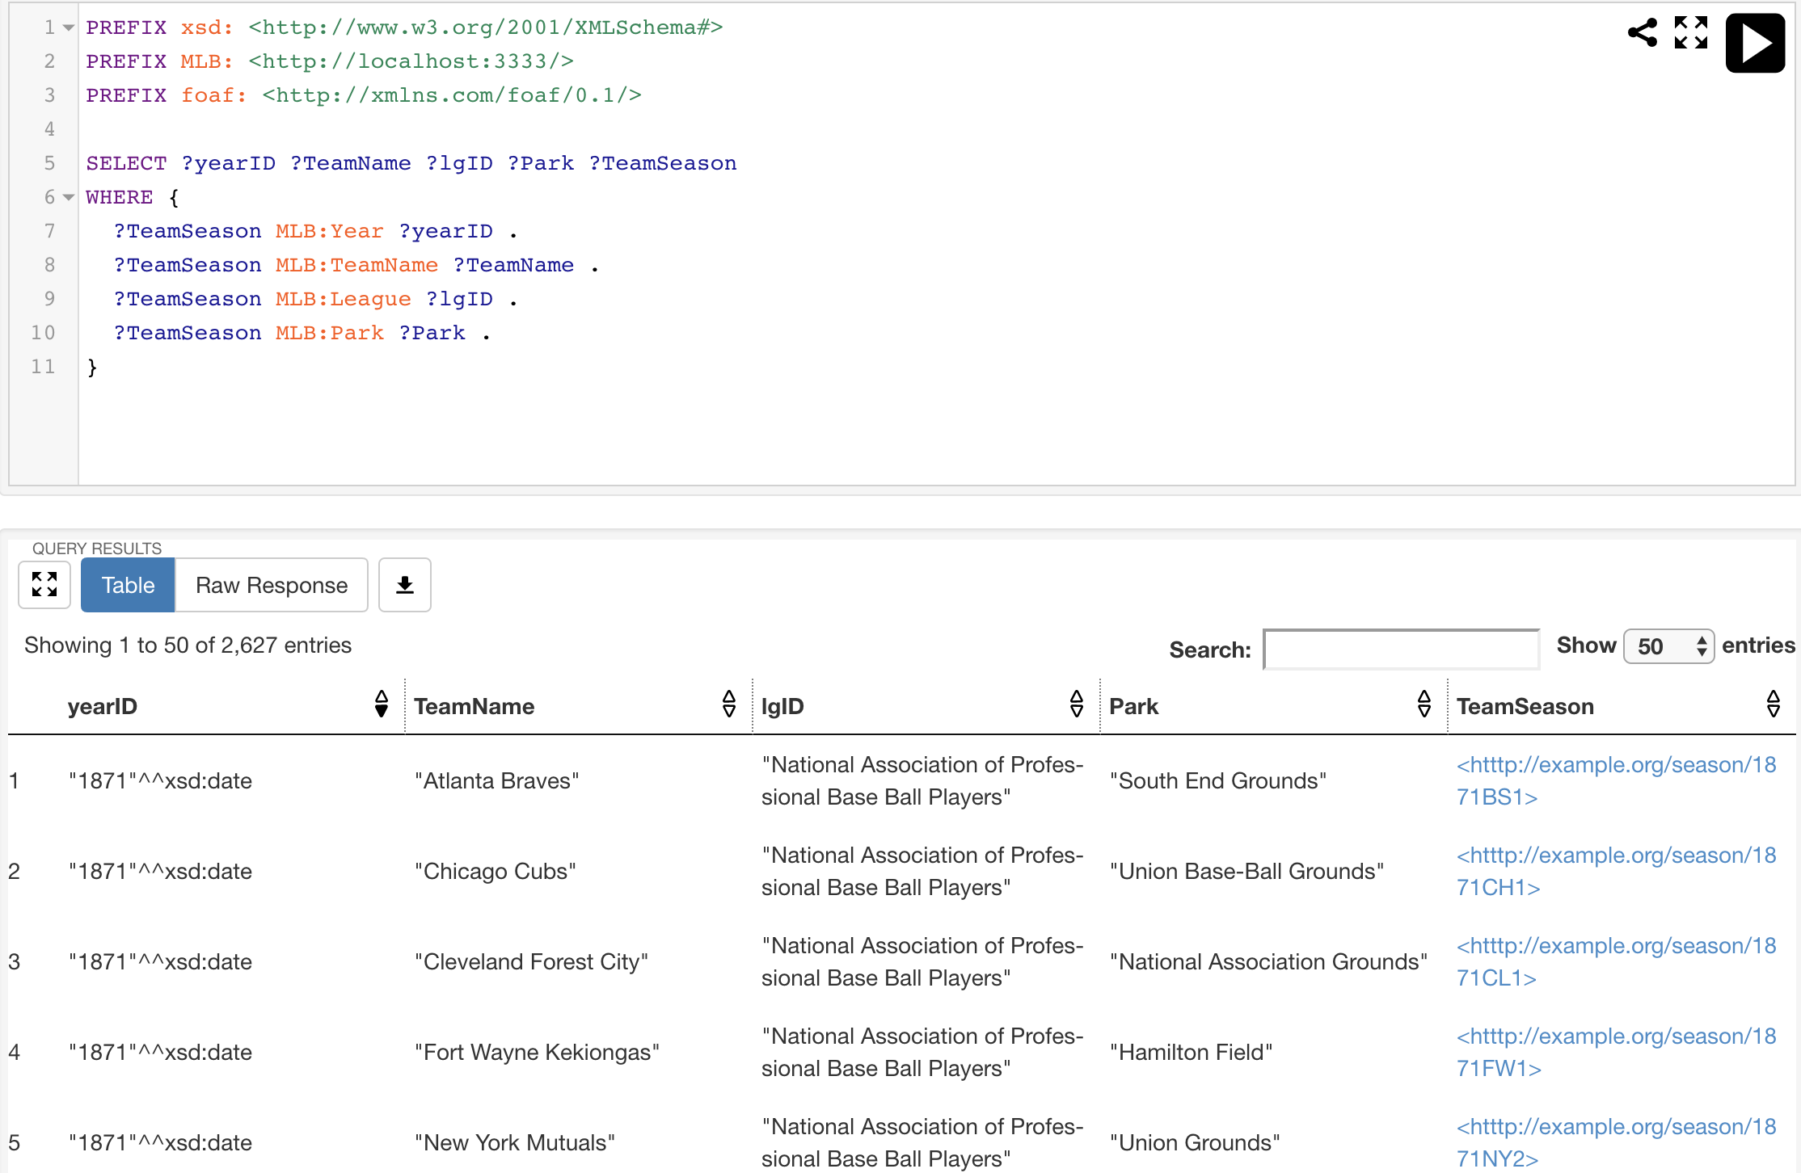
SPARQL Queries
Pre-reconciliation queries

Slide 7
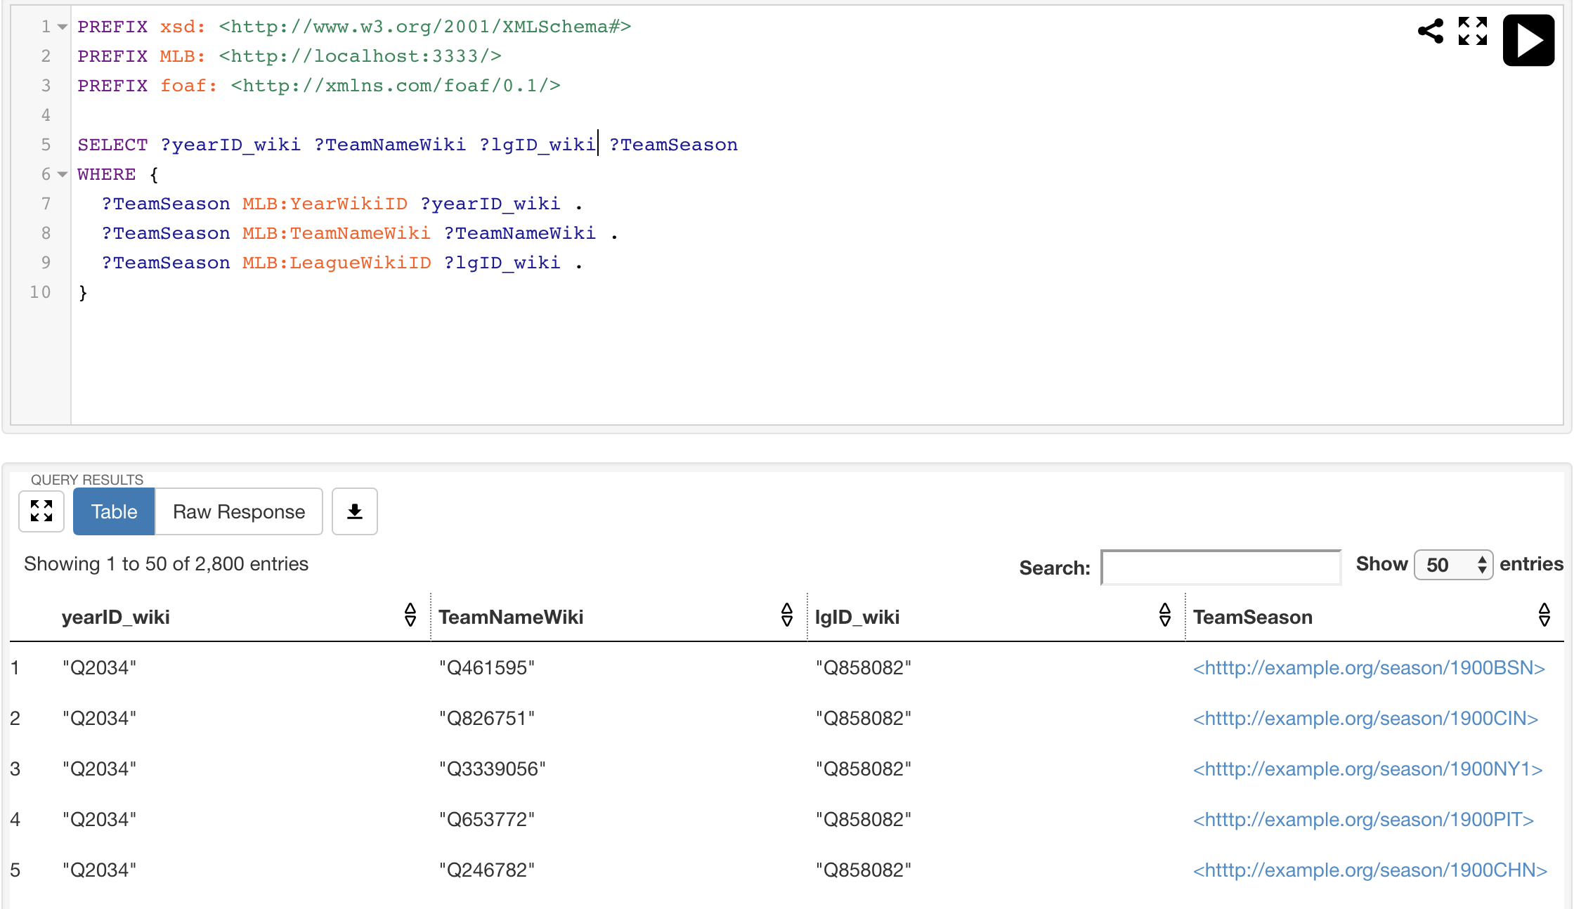
SPARQL Queries
Proof of Concept post reconciliation

Slide 8
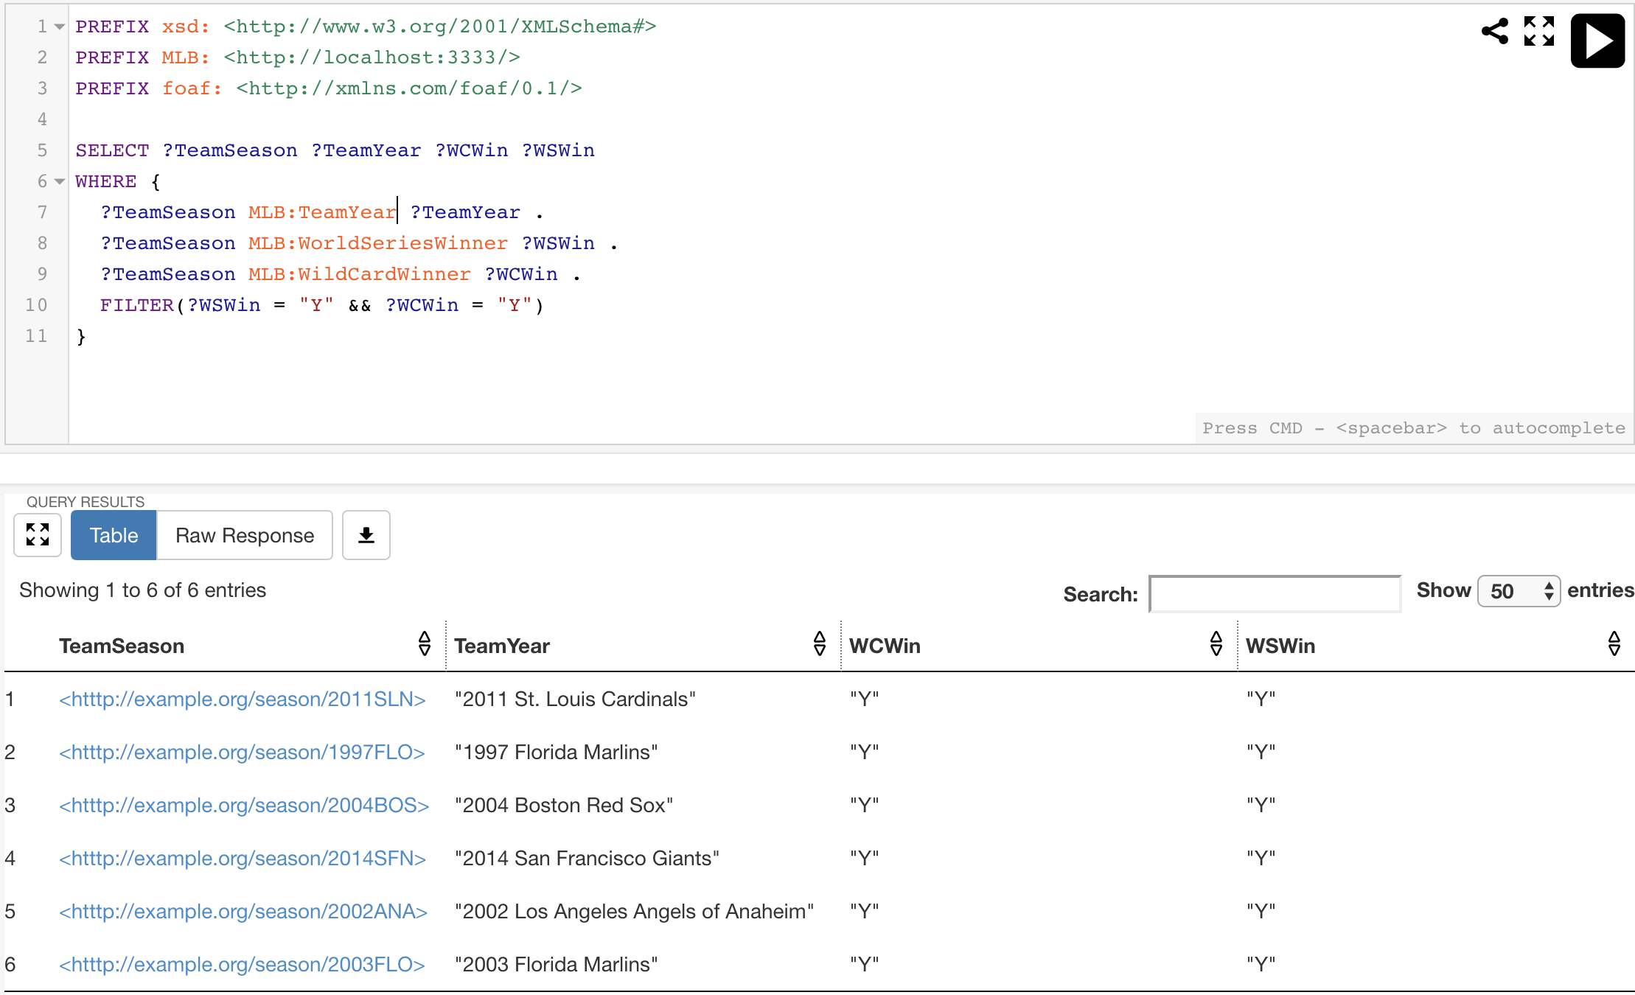
SPARQL Queries
Teams who won the Wild Card and World Series

Slide 9
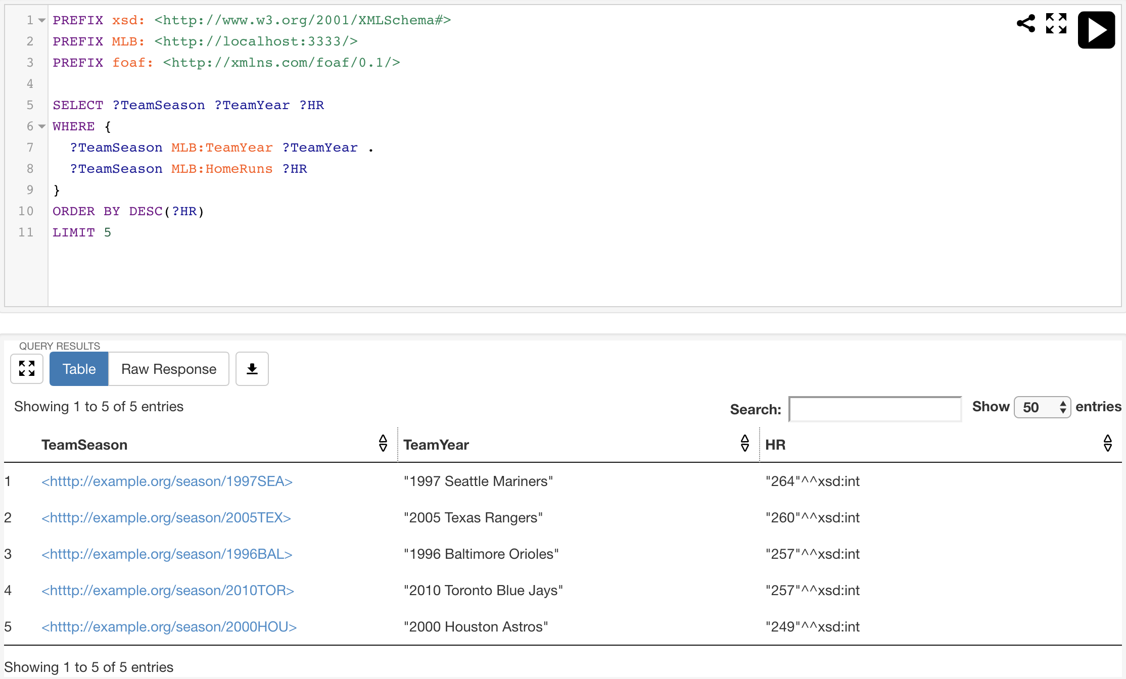
SPARQL Queries
The 5 teams who have hit the most homeruns in a season

Slide 10
Ideas for Visualization
Planning to utilize the SPARQL and ggplot2 packages in R
Have been able to get some of the correlational data from the numeric values
Biggest problem is that all of the values I reconciled with WikiData are categorical and harder to visualize
Working to statistics by team for since their conception in one row for visualization
Any ideas for how to show linked data as a part of this?

